Slide 1
RUNGTA COLLEGE OF DENTAL SCIENCES AND RESEARCH
PNEUMONIA
DEPARTMENT OF GENERAL MEDICINE

Slide 2
SPECIFIC LEARNING OBJECTIVES
MUST KNOW | NICE TO KNOW | DESIRE TO KNOW
TYPES | LOBAR PNEUMONIA | OTHER TYPES
SIGN AND SYMPTOMS | BRONCHOPNEUMONIA | CHRONIC PNEUMONIA
COMMUNITY ACQUIRED PNEUMONIA | NASOCOMIAL PNEUMONIA | NECROTISING PNEUMONIA
COMPLICATIONS | ASPIRATION PNEUMONIA

Slide 3
CONTENTS
INTRODUCTION
TYPES
SIGN AND SYMPTOMS
COMMUNITY ACQUIRED PNEUMONIA
LOBAR PNEUMONIA
BRONCHO PNEUMONIA
COMPLICATIONS
OTHER TYPES
NASOCOMIAL PNEUMONIA
ASPIRATION PNEUMONIA
CHRONIC PNEUMONIA
NECROTISING PNEUMONIA AND LUNG ABSCESS
CONCLUSION

Slide 16
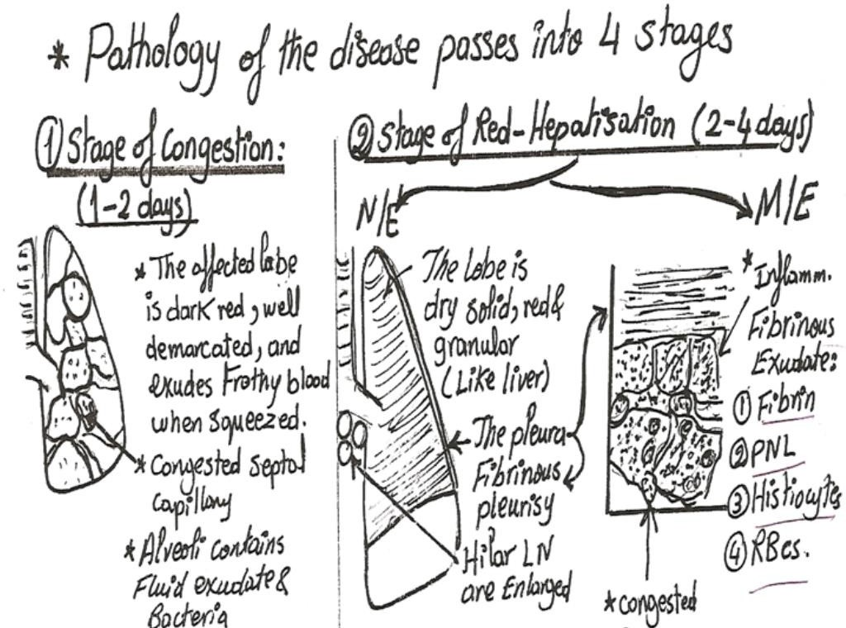

Slide 17
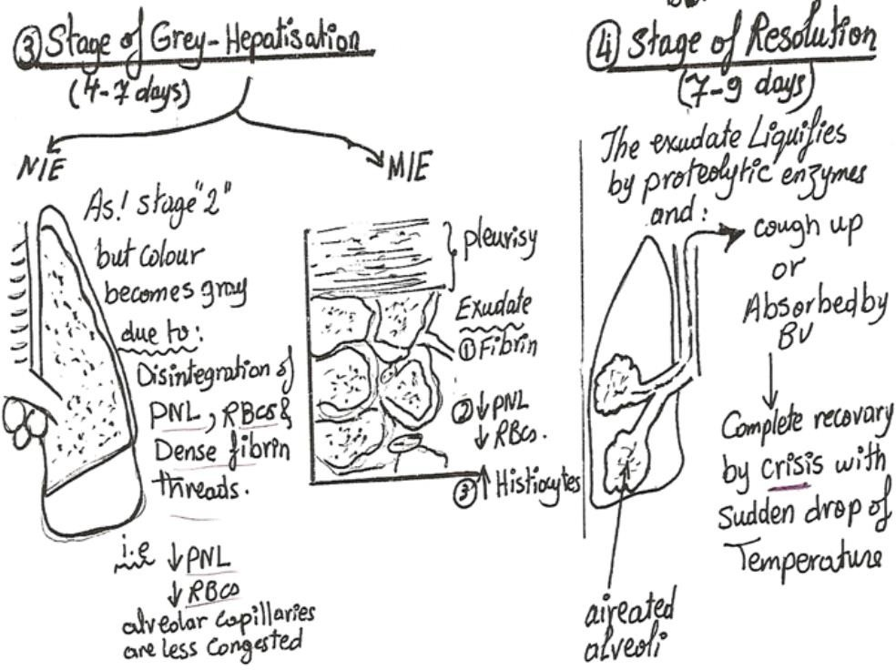

Slide 18
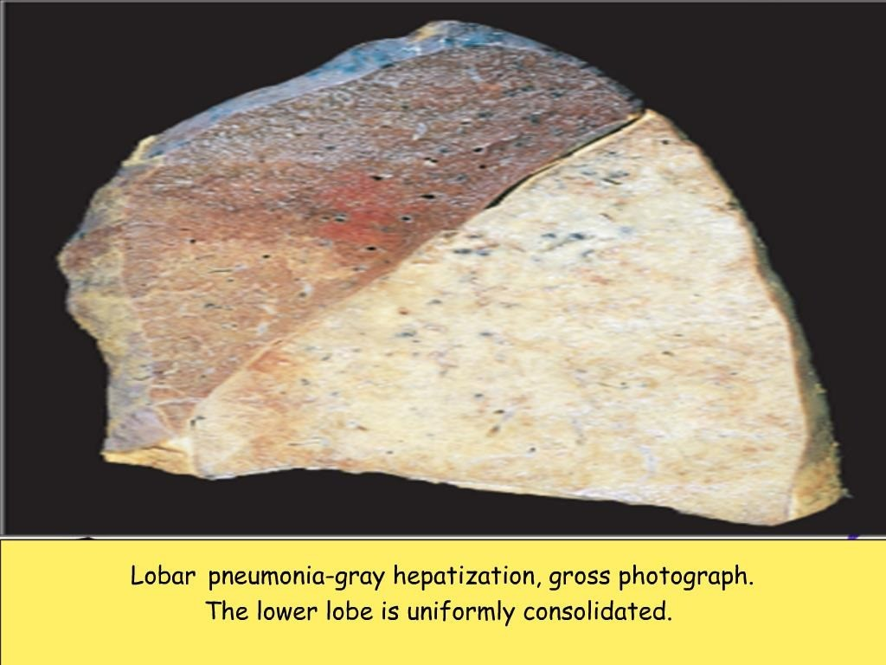

Slide 21
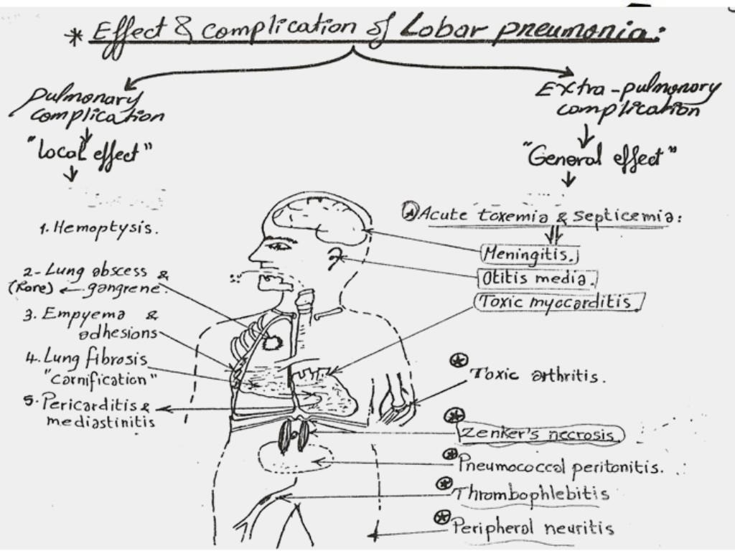

Slide 22
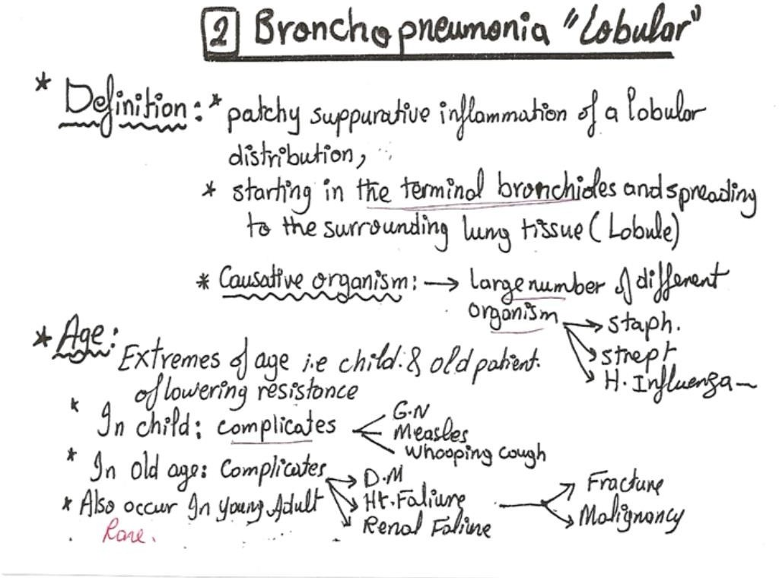

Slide 23
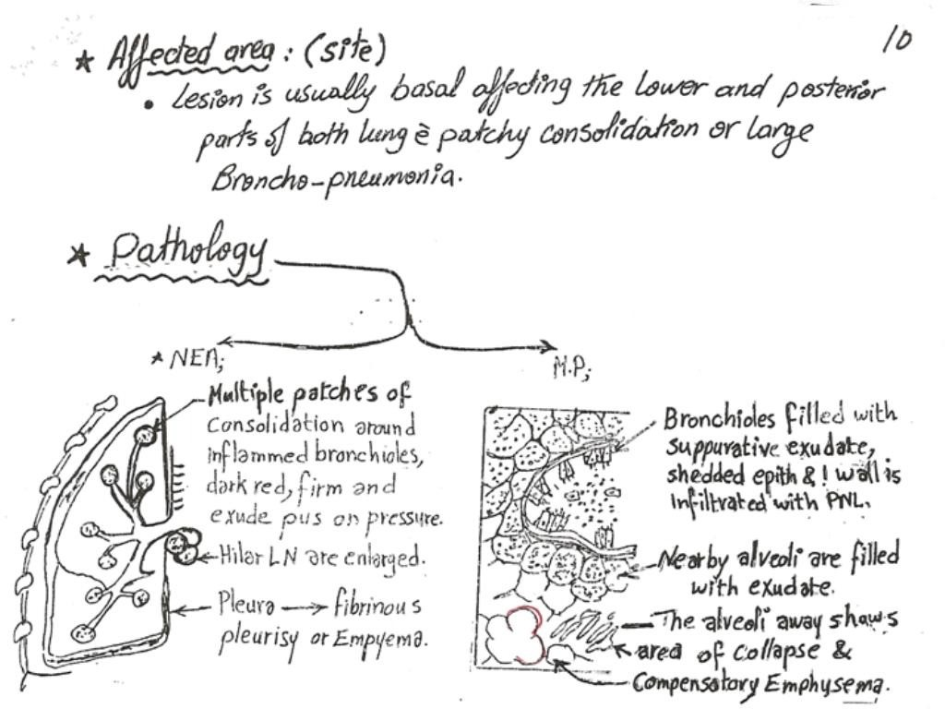

Slide 24
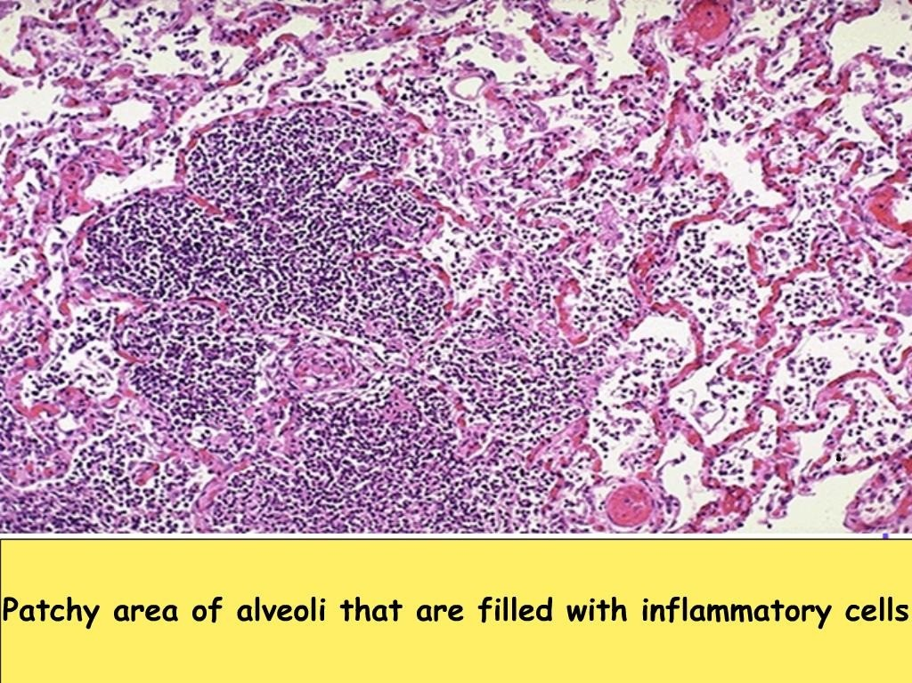

Slide 28
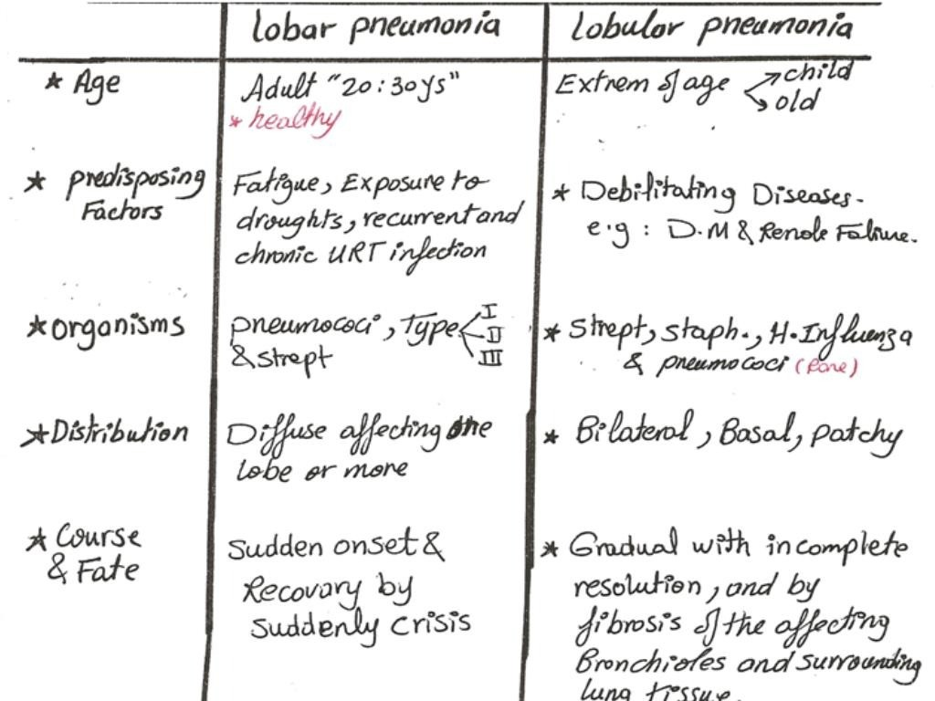

Slide 29
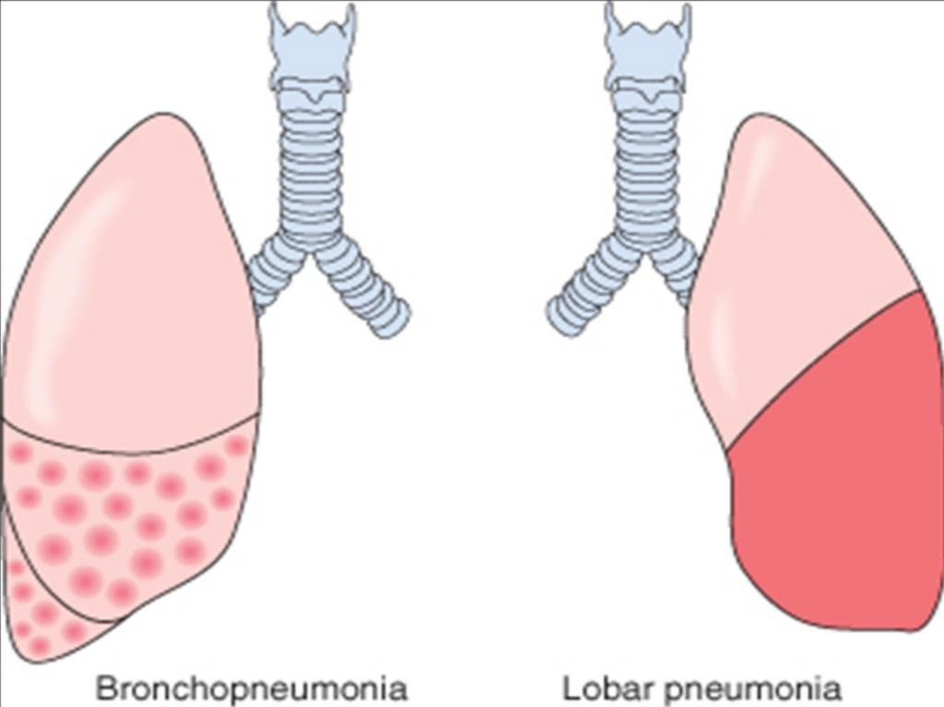

Slide 38
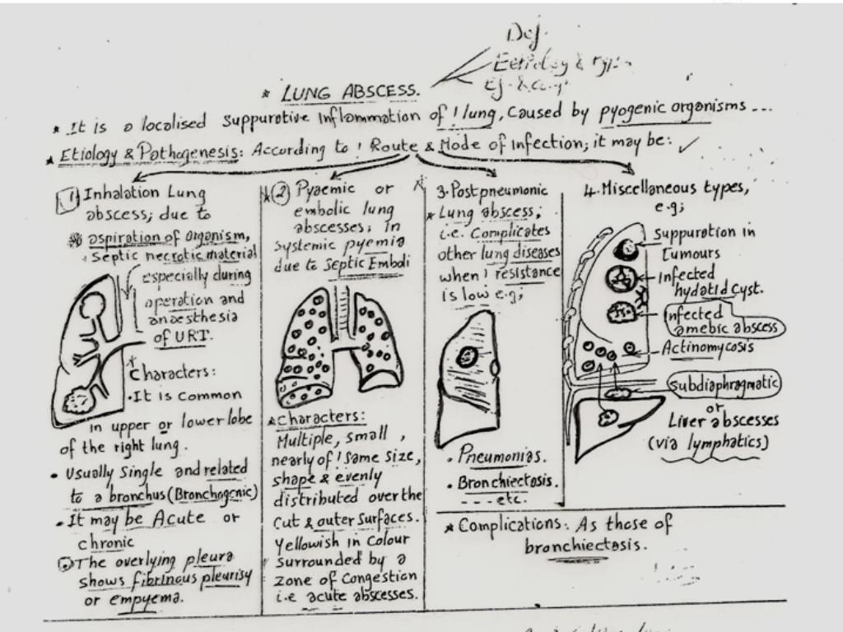

Slide 41
REFERENCES
DAVIDSON’S PRINCIPLES AND PRACTICE OF MEDICINE; 23rd edition
HARRISON’S PRINCIPLE OF INTERNAL MEDICINE; 21ST edition
TEXTBOOK OF CLINICAL MEDICINE by S.N Chugh ;5th edition

Slide 42
QUESTIONS AND ANSWERS

Slide 43
THANK YOU.....

